Slide 1

Project -1 San Francisco Auto Rental (SAR) Data Analysis
Phanidhar Venkata Naga Kasuba
STD ID : 4249169
CSDA 6010 - Data Analytics Practicum

Slide 2

Introduction
San Francisco Auto Rental (SAR) operates in the car rental market, handling 15,000 bookings per month.
This analysis examines 10,000 records to enhance predictive capabilities and optimize service delivery.

Slide 3
Business Problem & Goal
- Problem: SAR experiences 20% ride cancellations, affecting service reliability.
- Goal: predicting cancellations using machine learning with high accuracy .
- Optimize driver availability and booking fulfillment rates.

Slide 4
Data Understanding & Preprocessing
- Dataset: 10,000 bookings, 19 features.
- Missing values handled using MICE & KNN imputation.
- Feature Engineering: Distance calculation (Haversine formula), clustering (K-Means), and time-based features.

Slide 5
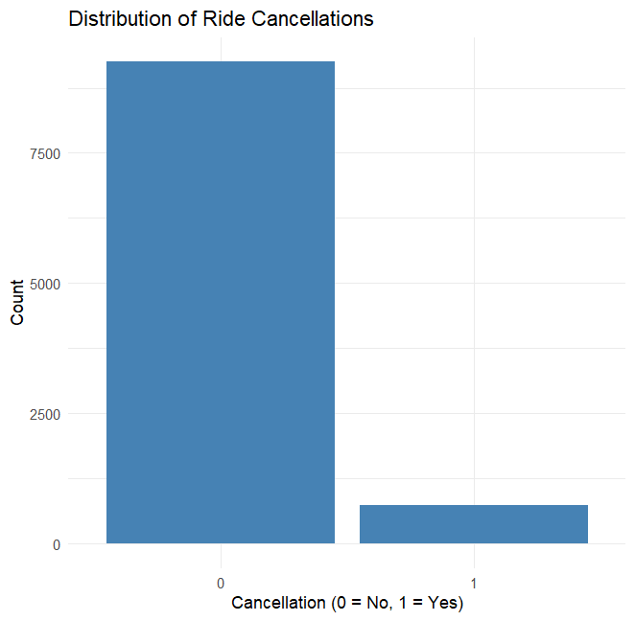
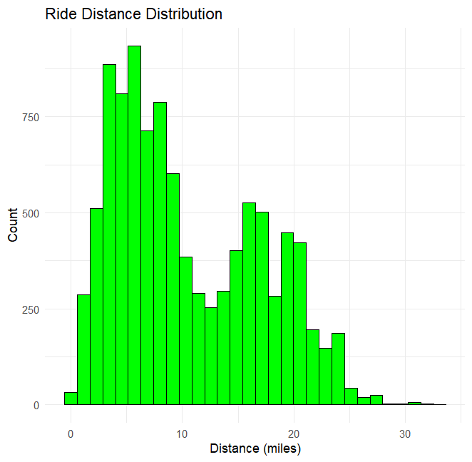
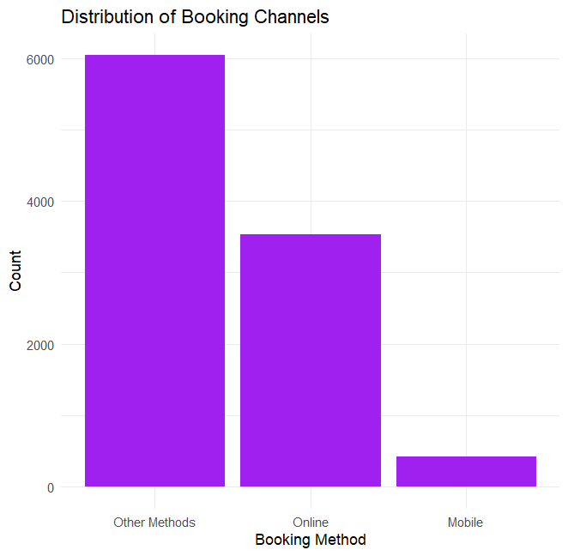
- Entire Dataset only has 7.43% Cancellations
- Mobile bookings have the lowest cancellation rate (0.7%)
- The Rides are maily for shorter distances

Slide 6
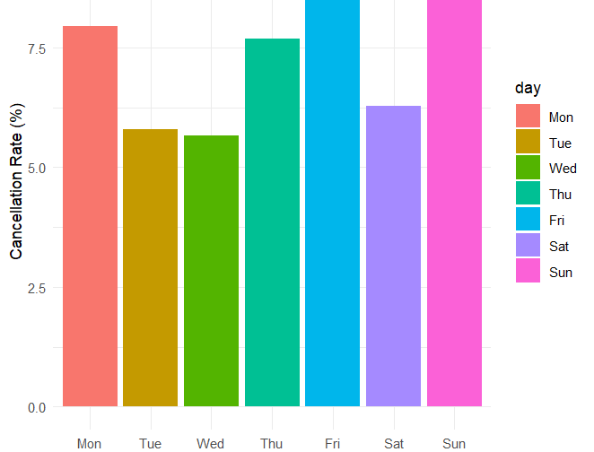
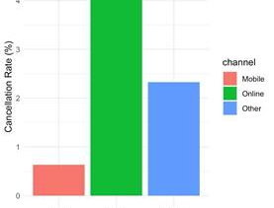
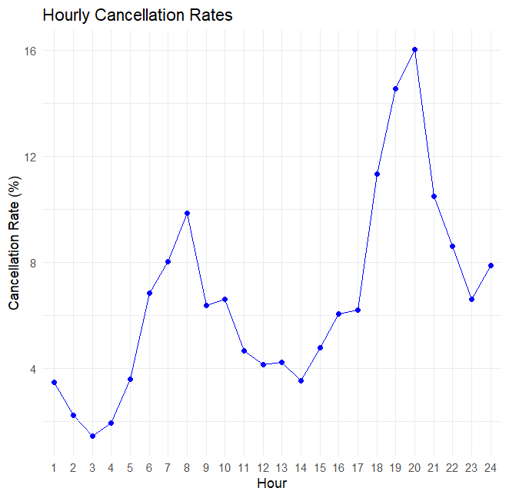
- Cancellation rate highest at night (9 PM -10PM around 16%).
- Weekend cancellations peak on Sundays (8.5%).
- Highest cancelations rate in online booking

Slide 7
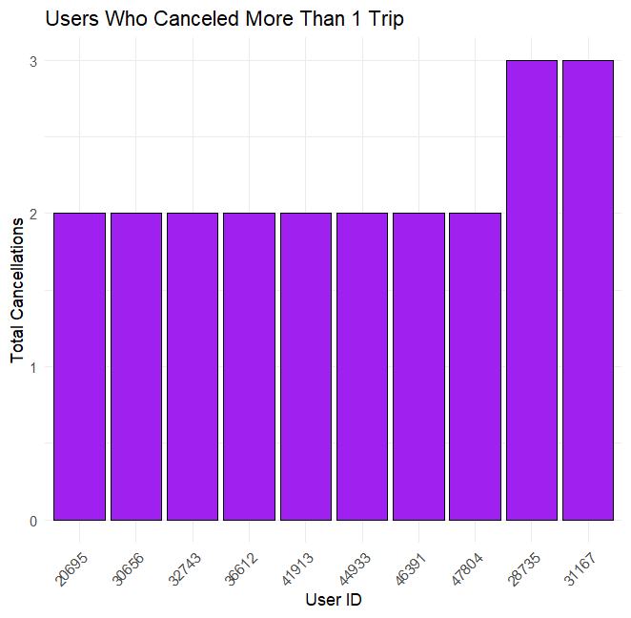
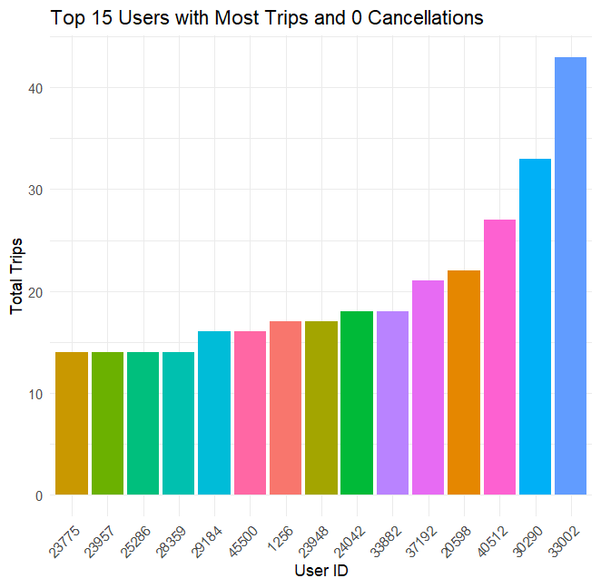
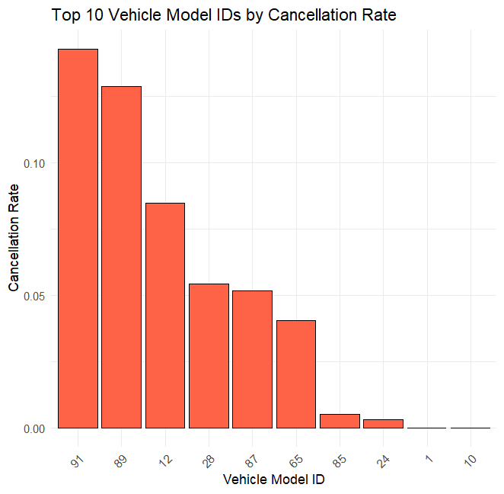
PLAN B

Slide 8
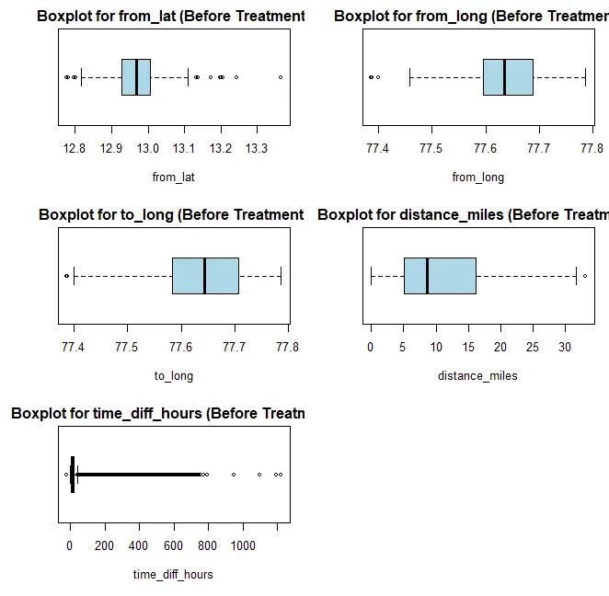
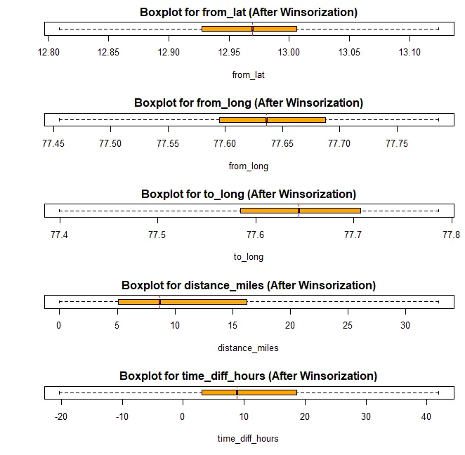
Handling outliers

Slide 9
Model Development & Evaluation
Model | Accuracy | Sensitivity | Specificity | Balanced Accuracy | Kappa Score
Naive Bayes | 76.70% | 0.7682 | 0.7517 | 0.76 | 0.2308
Logistic Regression (LASSO) | 92.45% | 0.9919 | 0.0621 | 0.5269 | 0.0877
Decision Tree | 91.25% | 0.9757 | 0.1034 | 0.5396 | 0.1885
K-Nearest Neighbors (KNN) | 92.50% | 0.9962 | 0.0338 | 0.515 | 0.052
Random Forest | 93.45% | 0.9924 | 0.2095 | 0.6009 | 0.297
Addressed class imbalance with oversampling technique.
Data Split – 80% Train and 20% Test

Slide 10
Business Impact & Recommendations
PLAN B
- Strategies:
- Incentives for high-reliability drivers.
- Predictive analytics for proactive service management.
- Enhanced mobile booking features for increased adoption.

Slide 11
Conclusion
-Naïve Bayes as top performance with specificity 75%
- Temporal, geographical, and booking factors impact cancellations.
- Implementation of predictive analytics can optimize SAR’s service reliability.

